Slide 1

Konshe-ruju
Ski Valet Services for Everyone

Slide 2
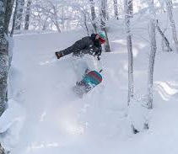
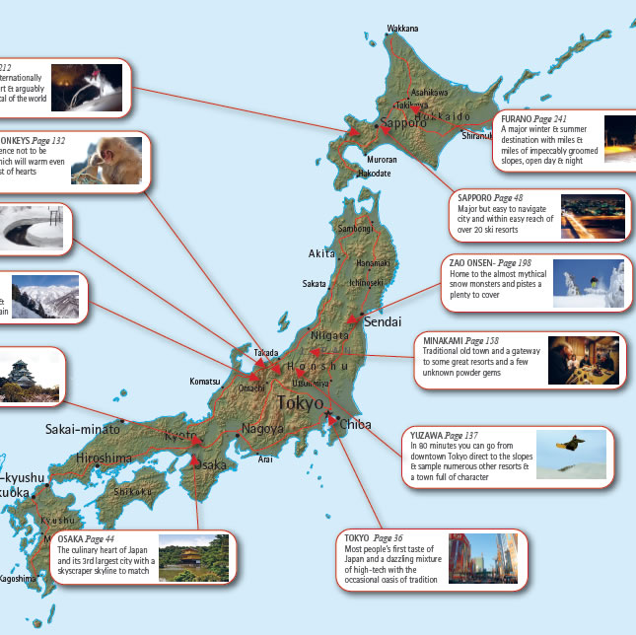
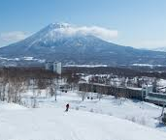
Introduction
Japan is a world-class ski and snowboard destination with abundant, high-quality snow, beautiful scenery and relaxing hot springs. There are over 500 ski resorts across japan from the northern island of Hokkaido to the southern island of Kyushu, which vary in size from large resorts with dozens of runs to small one-lift slopes. The best resorts and snow conditions are found in Northern Japan (Hokkaido and Tohoku) and in the mountains along the sea of japan coast (especially Niigata and Nagano).

Slide 3
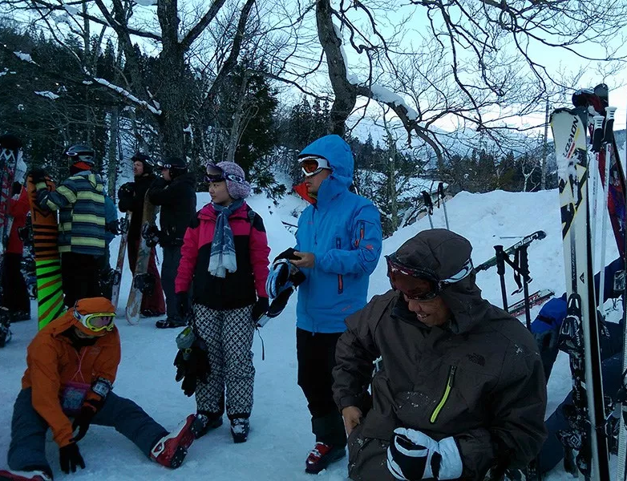
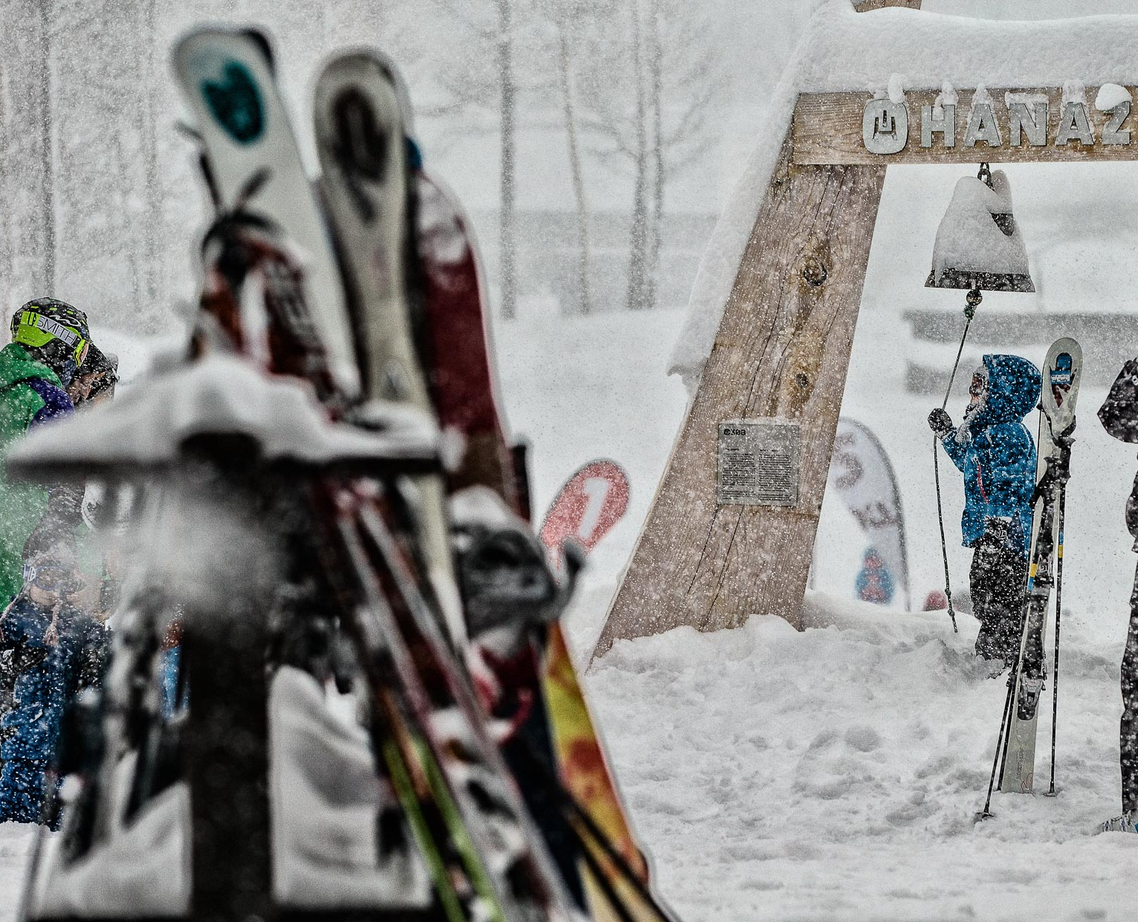
Problem
Currently in Japan, unless you are staying in a ski-in ski-out resort; the only way of getting to a ski resort is to take the resort bus shuttle or private cars. Current infrastructure in most resorts do not support large buses, hence shuttle buses are usually overcrowded during the peak hours. Those with families tend to be most affected by the current issues.
Storage facilities are limited in numbers, and can be expensive and most ski resorts do not offer overnight storage. Lockers facilities at the hotels tend to be overcapacity as the number of tourists has increased over the years.

Slide 4
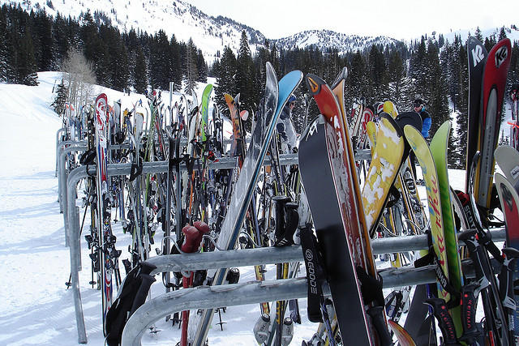
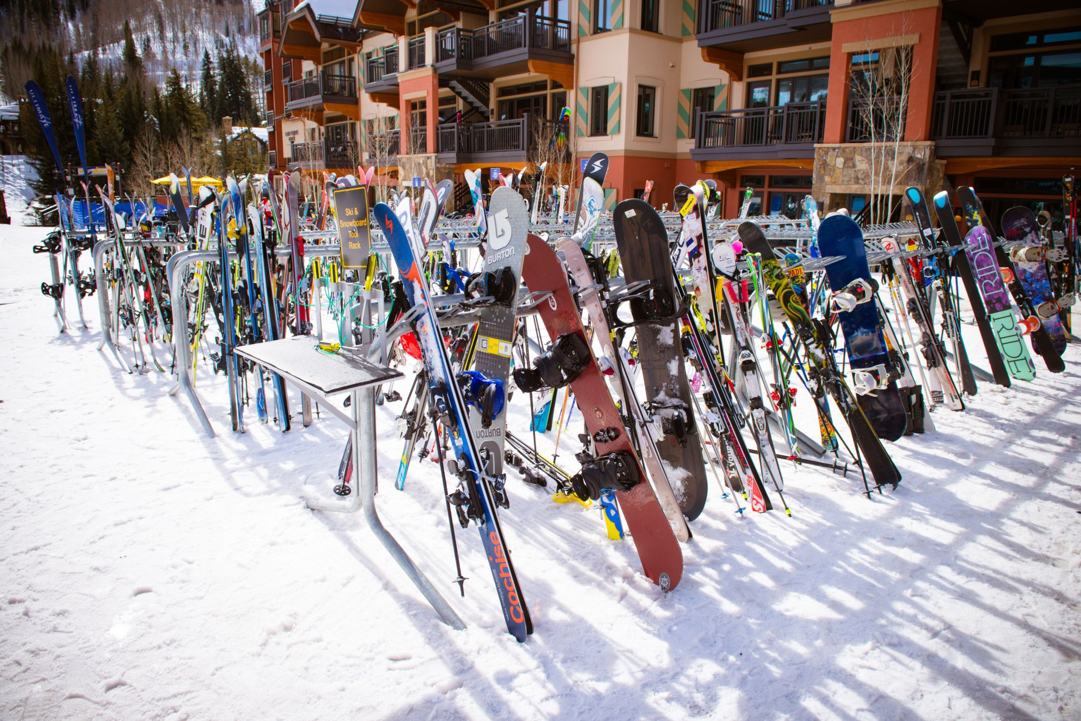
Solution
To provide daily equipment delivery and pick up service for skiers and boarders at the ski resort via an online mobile application. Users can choose delivery destination and timeslots on a daily basis.
This would give Hotels, Ryokans and Motels an opportunity to utilize the extra spaces to convert into rooms or areas for guests. Hence a chance to increase their revenue.
Will reduce congestion in the shuttle buses during the peak times, making the holiday less stressful, more fun and would certainly encourage return visits.

Slide 5
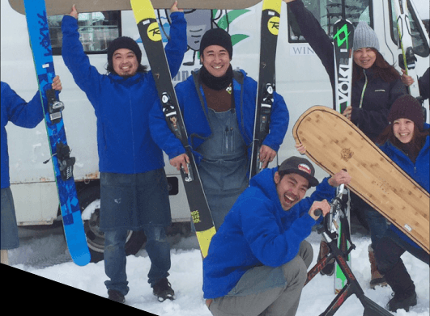
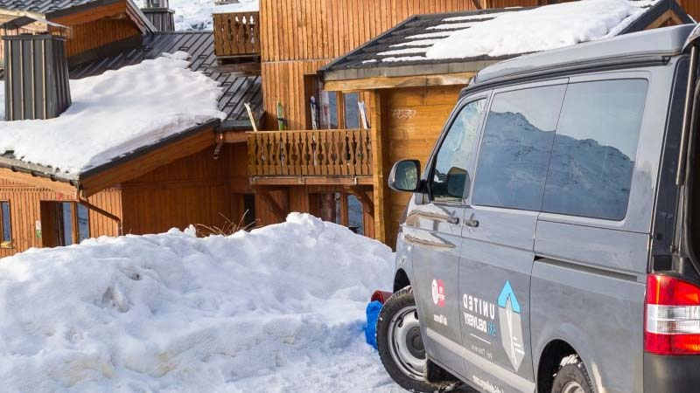
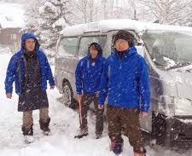
Product
Konshen-Ruju mobile application enables the user to book daily delivery and pickup timeslots. Users will also have the option to choose the resort they would like their equipment to be delivered to and pick up. The platform also enables the user to purchase ski lift passes. Payments are all made online hence reducing the need for physical cash.
Konshen-Ruju leases external storage facilities hence creating an opportunity to create income for the local population.
Konshen-Ruju have plans to outsource the majority of its delivery business to the local network of drivers.

Slide 6
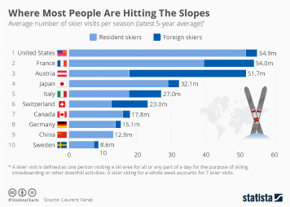
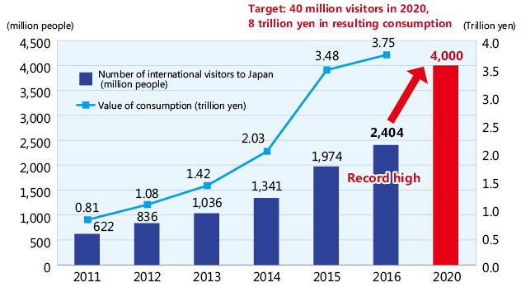
Market
On average, there are over 32 million skiers per season in Japan. Although foreign skiers make a small percentage in comparison to the total numbers, the number of overseas skiers are on the increase. Events such as Tokyo 2020 Olympics, Beijing 2022 Winter Olympics as catalysts for the increase of tourism in Japan.
The Japanese skiing industry was emulating marketing moves that golf industry entrants had undertaken. Among their efforts were: • Emphasis on young families with children, for example, child-care facilities • Innovative pricing techniques, for example, a discounted initial lift ticket or package with subsequent lowered prices for future visits or a “membership fee” entitling the holder to discounted prices and gifts.
Attraction of skiers from other nations, for example: For Australians the cost of a Japanese ski trip was half that of a North American trip with the advantage of no jet lag. In South Korea there was an estimated four million skiers attempting to use the country’s 13 ski resorts, a phenomenon similar to that experienced in the country’s golf industry. Many expected that China might be the next market for skiing in Japan as there was a current emphasis in China on selling Japanese ski goods.

Slide 7
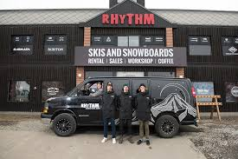


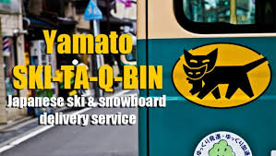
Competition
Currently, there are no daily delivery service of ski equipment in Japan. Yamato or Ta-Q-Bin only offers delivery service from the airport to the hotels. Rhythm Sports and other ski rental outlets offers delivery and pickup of rentals as a one off service.

Slide 8
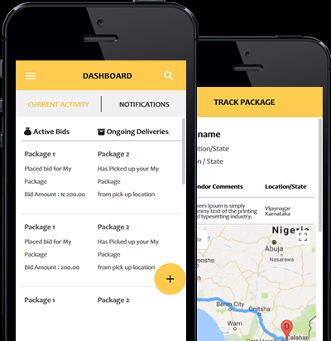
Business model
A mobile application which will accepts bookings to pickup and delivery ski equipment to the ski resort of your choosing on a daily basis. Payment can only be made online. The application will also confirm when the items have been delivered and picked up.
The mobile app will be fitted with GPS capabilities and QR reader to ensure that all equipment can be traced.

Slide 10



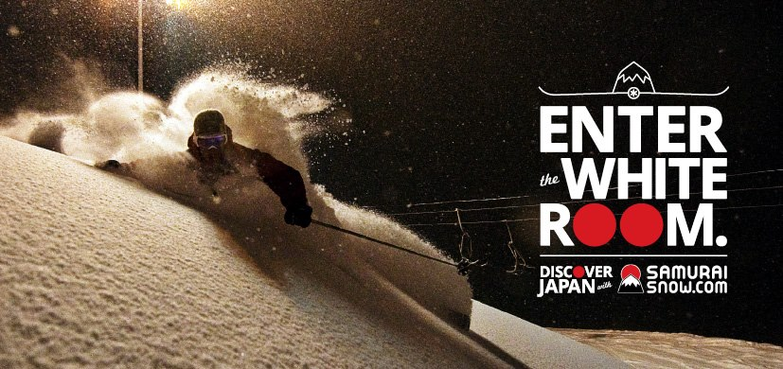







Partners

Slide 11
https://weeedwin/2.wixsite.com/website
Thank you.

